Slide 1

Mouth Wise
Oral Health Curriculum
Development and Training by McMillen Health
Notes:
Welcome to the training for Mouth Wise, an oral health curriculum from the North Carolina Dental Society, developed by McMillen Health, and funded by the Delta Dental Foundation of Michigan, Ohio, Indiana, and North Carolina. My name is ____ and I’m from McMillen Health, a health education center in Northeast Indiana.

Slide 2

Objectives
Define oral health related terms used in the Mouth Wise curriculum
Understand the impact oral health has on overall health
Understand the impact oral health has on student success
Understand oral health basics and oral hygiene
Learn how to use Mouth Wise curriculum
Notes:
Today, we will be going over definitions of some terms you will encounter throughout the curriculum. We will then talk about how oral health impacts your students, in terms of both their overall health and their success in school. Next, I’ll cover the basics of oral health and oral hygiene. Last, we will talk about how to use the Mouth Wise curriculum with your students.

Slide 3
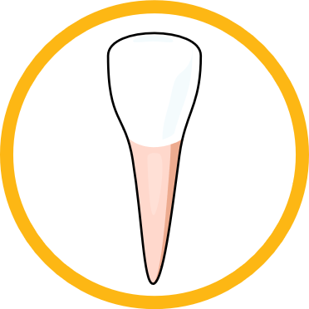
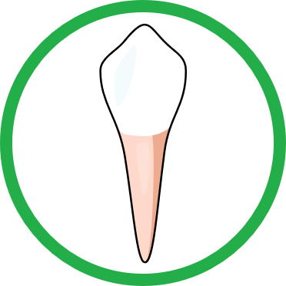
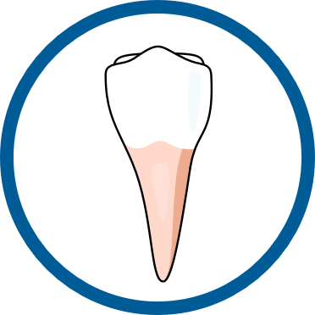
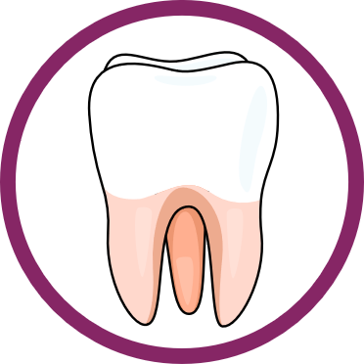
Definitions
Tooth types
  Incisors – front teeth, used to cut
  Cuspids/Canines – sharp corner teeth, used to tear
  Premolars – tear and grind
  Molars – back teeth, used to grind
Primary/baby teeth
  20 teeth by about 3 years old
  Start to be lost around 6 years old
Permanent/adult teeth
  32 teeth total, 28 of those by age 12 (wisdom teeth come later)
Notes:
Some of these terms may seem basic to some of you, but we want to make sure everyone is on the same page and understands them in a way that will be useful to you as you talk to your students about their oral health.
There are four types of teeth. Incisors are your teeth in the front. They have a flat, sharp edge that is used for cutting. These are good for biting into foods like bread or an apple. Next to these are cuspids, or canines as they are commonly called. These have a pointy, sharp edge and are used for tearing foods. These are good for eating meats and tougher foods that you can’t bite as easily with your incisors. Between the cuspids and molars are premolars. These help the cuspids tear and help the molars grind. In the back are molars. These are mostly flat and are used to grind foods. These are great for crushing up fruits, vegetables, and nuts.
Primary teeth are the teeth we usually hear called baby teeth. Most children will have all 20 primary teeth by the time they are 3 years old and will start losing them around 6 years old. When we lose our primary teeth, the permanent, or adult, teeth start coming in right behind them. We have a total of 32 permanent teeth, although some people’s wisdom teeth don’t come in before they are removed.

Slide 4
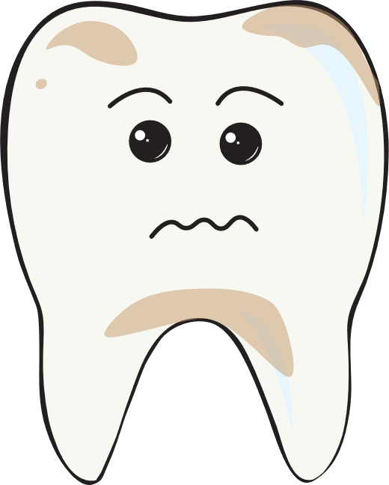
Definitions
Plaque
  Sticky film of saliva and bacteria
Tartar
  Plaque that has hardened
Cavity or dental caries
  Hole in the tooth
  Chronic, infectious, and transmissible
Notes:
Plaque is a sticky film that starts covering our teeth every time we eat or drink anything other than water. It is a mixture of saliva and bacteria. As you will see shortly, the bacteria in plaque is what leads to cavities, so it is important to remove plaque with brushing and flossing. If plaque is not removed, it can harden and turn into what we call tartar. Once tartar forms, it can only be removed by a dental professional.
Caries is a term for tooth decay or cavities. A cavity is a hole in the tooth. We will talk soon about why cavities can be bad for your whole body, not just your teeth. Cavities are chronic because they cannot be cured, they can only be filled to help prevent them from getting worse. If cavities are bad enough in primary teeth, they can also impact the permanent teeth, causing cavities in the permanent tooth. The bacteria that cause cavities can be passed from one person to another. In kids, this is common when a parent eats from the same utensils as children.

Slide 5

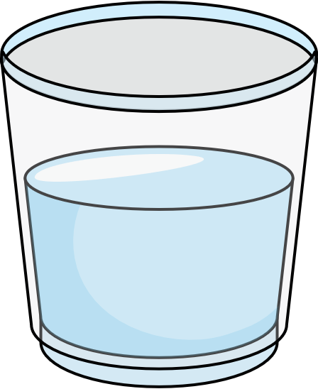
Definitions
Nutrition
  Eating for a healthy body
  Balanced eating pattern that limits unhealthy foods
Fluoride
  Mineral that strengthens teeth
  In some toothpaste and mouthwash
  Present in most water supplies
Notes:
Nutrition means eating for a healthy body. For the purposes of this curriculum, we want to point out that teaching children about nutrition should not be about good and bad foods. It is important that we don’t call any food bad. Many children are in food insecure homes where no food is bad food. Instead, we should be teaching nutrition from the perspective that some foods are healthy for our teeth and bodies and other foods are not healthy and should be limited whenever possible.
Fluoride is a mineral that our teeth need to stay strong. We need to supply our teeth with fluoride so they are strong and can resist getting damaged by acids that try to eat away at tooth enamel. In many places, fluoride is either found naturally in the water supply or is added when the water is treated for drinking. Fluoride in water certainly helps, but to have the strongest teeth possible, it is important to use oral hygiene products with fluoride.

Slide 6

Why is Oral Health Education Needed?
Untreated decay
  20% of 5–11-year-olds have at least one untreated cavity
Income
  Youth (5-19 years old) from low-income households are twice as likely to have untreated cavities, compared to youth from higher-income households
Notes:
To give you an idea of the extent of the problem, let’s take a look at a couple of oral health statistics. 1 in 5, or 20%, of children between 5 and 11 years old have at least one untreated cavity. This means that if you teach kindergarten through 5th grade, 1/5 of the students in your classroom could have a cavity right now that is causing them pain and discomfort.
Decay is not distributed equally across children and adolescents. Youth from low-income households are twice as likely to have untreated cavities. This is partly due to a difference in access to dental care, but it is also because of the food insecurities I mentioned earlier. If a family cannot afford healthier foods or doesn’t have time to prepare home-cooked meals, those children are more likely to eat foods higher in sugar, which are less healthy for teeth.
U.S. Centers for Disease Control and Prevention. 2019. Oral Health. Accessed December 15, 2020. https://www.cdc.gov/healthyschools/npao/oralhealth.htm

Slide 7

Why is Oral Health Education Needed?
Physical health
  Nutrition
  Pain, discomfort
  Chronic infections
Social and mental health
  Self-esteem
  Making friends
Notes:
It’s common to hear people say, “they’re just baby teeth, so it doesn’t matter if they have cavities.” However, oral health issues are not isolated to within the mouth. They can have lasting effects on the whole body and the mind. When we have cavities or other oral health issues, it can cause quite a bit of pain and discomfort. This means students may not be able to pay attention in class or may act out with misbehaviors. They can’t eat healthy, crunchy foods as easily, so they aren’t likely to have balanced nutrition. And they are more prone to chronic infections, like repeated ear infections.
Oral health issues can also have a significant impact on social and mental health. If a student has visible decay, their self-esteem may be lowered. As we know, other children can tease and make a child with decay feel bad about the condition of their oral health.
Sheiham, Aubrey. 2005. Oral health, general health and quality of life. Bulleting of the World Health Organization. 83(9): September 2005, 641-720.

Slide 8

Why is Oral Health Education Needed?
GPA
  Students with tooth pain are 4x more likely to have a low GPA
Missing school
  Elementary – 58 hours
  per 100 students
  High school – 80 hours
  per 100 students
Notes:
Poor oral health can have a negative impact on your students’ school success as well. For example, students with oral health pain are 4 times more likely to have low grades. Missing school is a huge side effect of poor oral health as well. For every 100 elementary students, 58 hours of school are missed due to oral health problems. In high school students, as many as 80 hours are missed. School attendance has a direct correlation to the likelihood a student will graduate high school. As you can see, oral health even in very young students can have a lasting impact on their success.
Seirawan, Hazem, Sharon Faust, and Roseann Mulligan. 2012. The Impact of Oral Health on the Academic Performance of Disadvantaged Children. Am J Public Health. 102(9): 1729-1734.

Slide 9
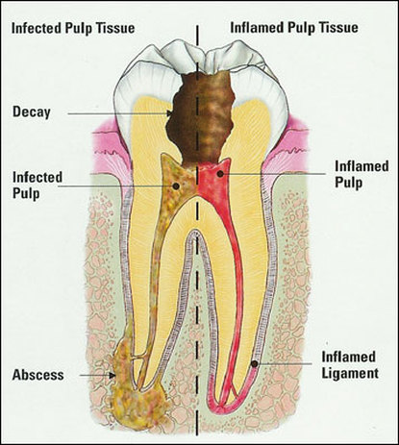
Notes:
Here is an image of the inside of a tooth. The inner layer, or the pulp, contains blood vessels and nerve endings. If there is an untreated cavity, bacteria from the mouth can get into the blood supply similarly to how bacteria can get in through a cut in the skin. The bacteria can then cause secondary infections all over the body.

Slide 10



Oral Health Basics
Sugar + Bacteria = Acid
Notes:
So, how exactly does a cavity form?
We aren’t born with decay-causing bacteria, but we can get it from our caregivers and family members.
These bacteria feed on sugar from our food and drinks. Many foods and drinks, except for water, have sugar. Even vegetables have some sugar.
When the bacteria feeds on that sugar, it forms acid as a byproduct. This acid byproduct, plus acid from things like carbonated drinks can eat away at tooth enamel.

Slide 11
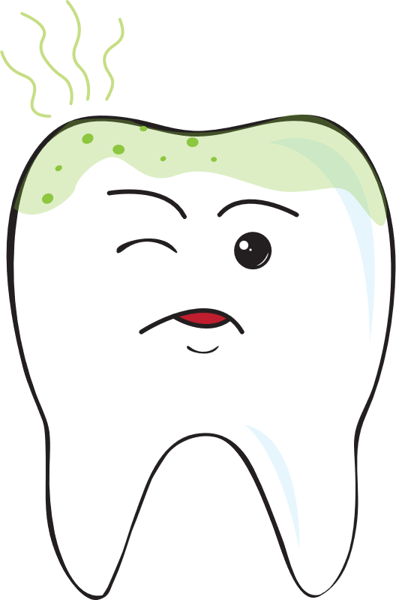
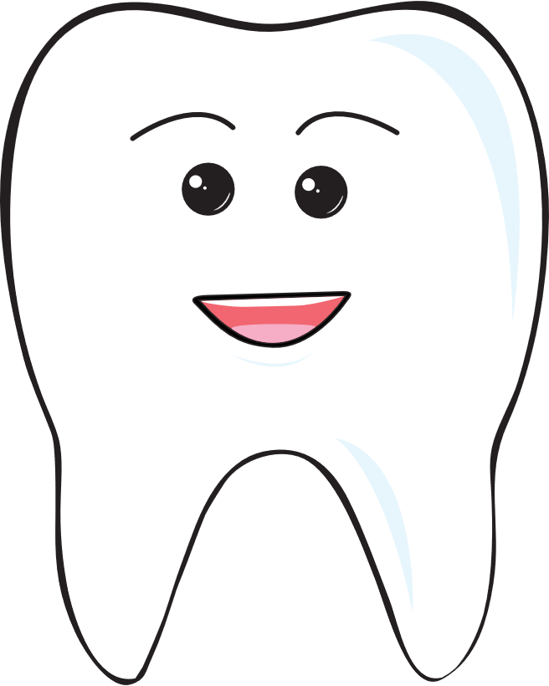
Oral Health Basics
Acid + Healthy Tooth = Tooth Decay
Notes:
If we have too much sugar in our diet and if we don’t brush and floss like we should, we will start to get tooth decay.
Saliva does help rinse sugar out of our mouth to some degree, but it takes time. That is one reason why it’s important to avoid snacking all day. So we don’t have a constant source of sugar for the bacteria to feed on.

Slide 12
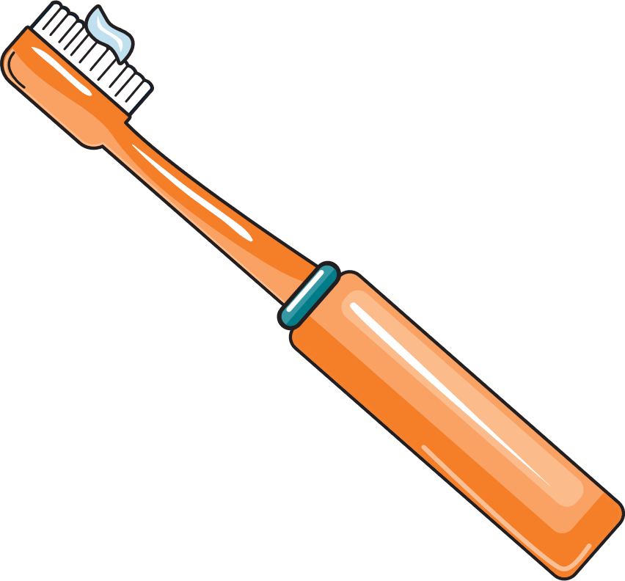
Oral Health Basics
Daily care
  Brushing – 2x a day for 2 minutes
  Use a pea-sized amount of fluoride toothpaste
  Flossing – 1x a day
Limit sugary foods and drinks
Drink water
Limit all-day snacking
Visit the dentist every six months
Notes:
Now that we’ve learned about the reasons why oral health is so important, let’s take a look at what regular oral health care should look like. Everyone should be brushing their teeth at least 2 times a day for 2 minutes each time, using a pea-size amount of fluoride toothpaste. When you talk to your students about this, it might be a good idea to practice what 2 minutes is. For example, their favorite song might be 2 minutes long or it might take 2 minutes to walk from the classroom to the lunchroom. We should also be flossing once a day. Younger students may need help from a parent or caregiver with both brushing and flossing.
As I mentioned a moment ago, we should try to limit the amount of sugar in our mouth. This means, limiting the sugar we eat and drink, but also drinking plenty of water to rinse the sugar down, and limit eating to meal and snack times instead of grazing all day long.
And finally, a visit to the dentist every 6 months is important so they can catch any signs of dental decay before it becomes a bigger issue.

Slide 13
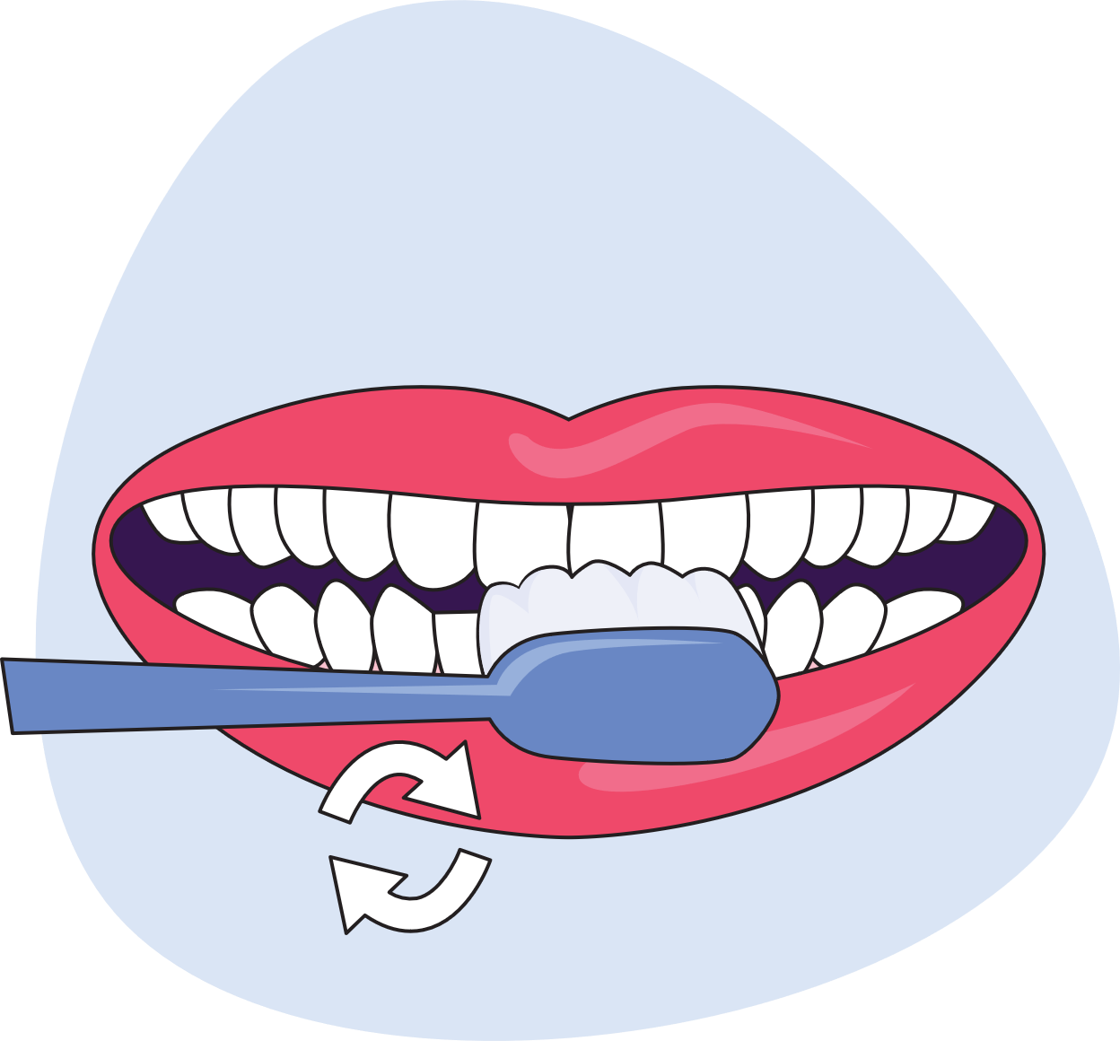
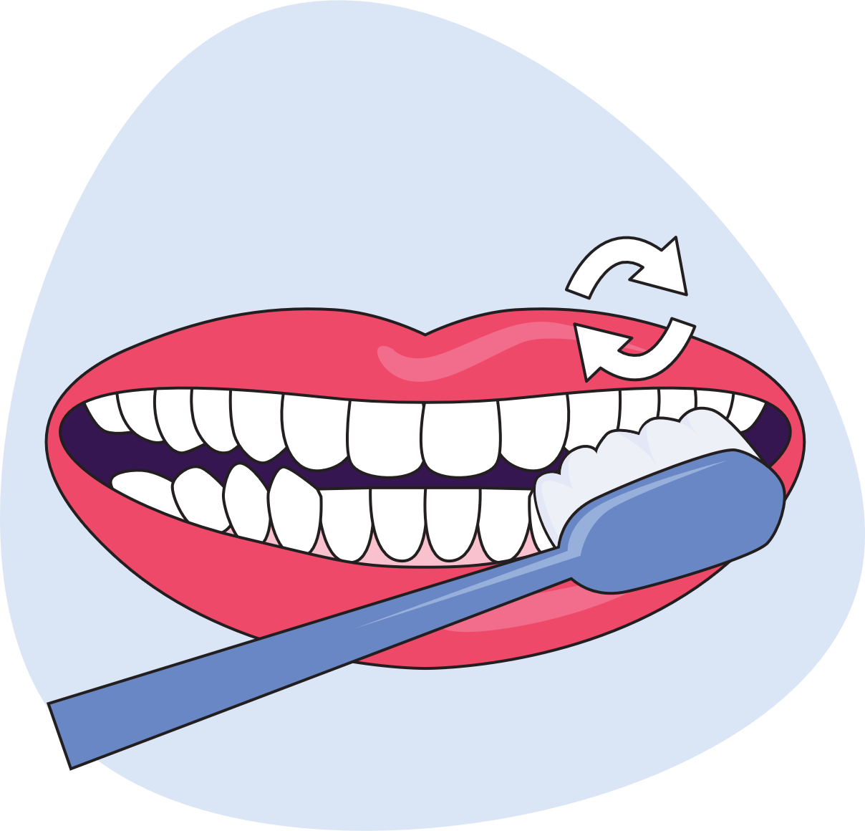
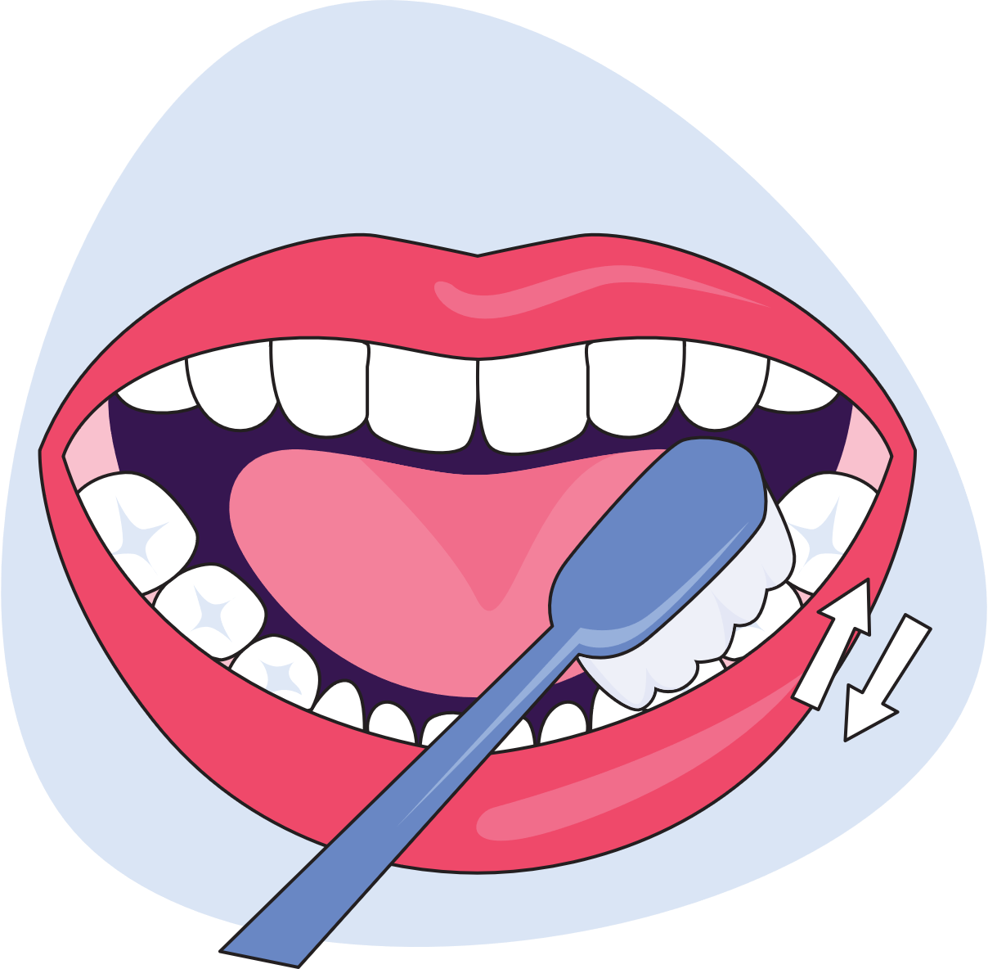
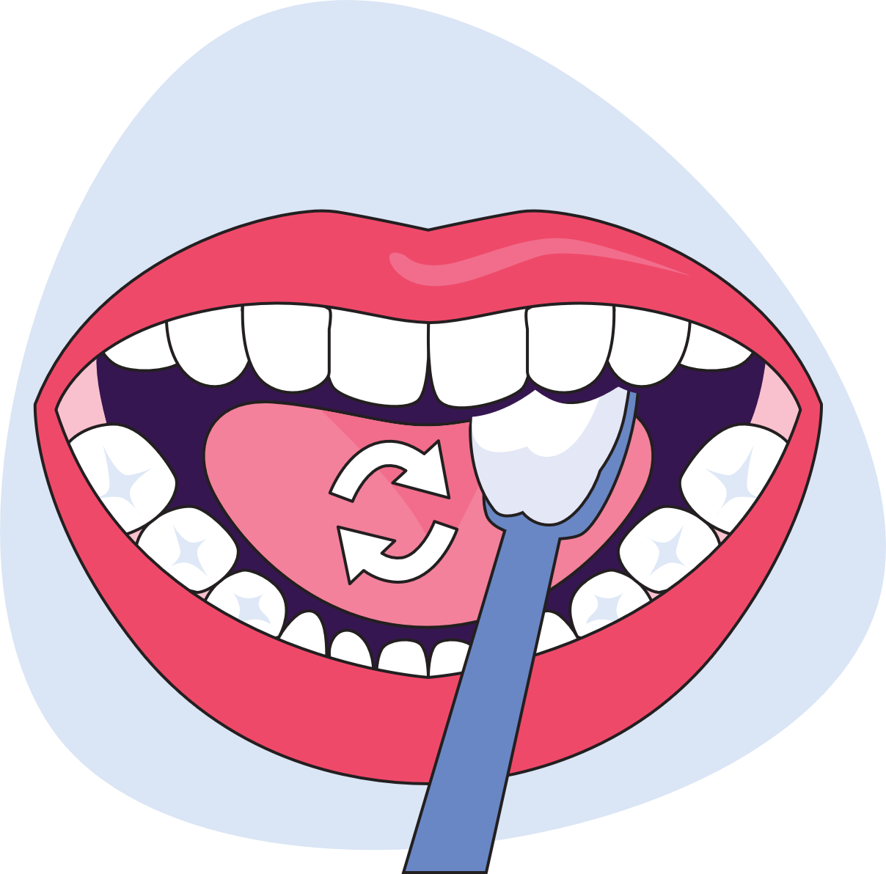
Oral Health Basics
Notes:
Proper brushing techniques are important! To brush teeth correctly, place your toothbrush at a 45-degree angle to the gums. Gently move the brush in small circular strokes. Brush the outer surfaces, the inner surfaces, and the chewing surfaces of the teeth. To clean the inside surfaces of the front teeth, tilt the brush vertically and make several up-and-down strokes. Continue this for 2 minutes, then spit out the extra toothpaste.
*Trainer will have a mouth model to demonstrate proper brushing.

Slide 14

Oral Health in Kindergarten - Grade 2
Children typically start losing teeth around 6 years old
The health of primary teeth affect permanent teeth
Bacteria and habits that lead to cavities may already be present
Notes:
If you are teaching students in kindergarten through 2nd grade, there are a couple of things you’ll need to know about their oral health. Children will typically start losing their teeth at about 6 years old. Children can be scared or excited about losing a tooth, but it is important you let them know it is a normal thing that happens as they grow up!
It is also important to know that their primary teeth affect their permanent teeth. The roots of the primary teeth wrap around the permanent tooth underneath it. When a baby tooth falls out naturally, the roots have resorbed, so often people don’t realize primary teeth have roots.
If primary teeth are removed early because of decay, their permanent teeth under the gums can shift dramatically. This can result in a child having permanent teeth so far out of alignment that it is a medical issue, not a cosmetic issue. These children can have pain in their teeth and jaws that can last a lifetime.
Children of this age are also forming habits that they will take with them throughout their life, so it is important they learn how to care for their teeth as early as possible.

Slide 15

Oral Health in Grades 3 – 5
Children will typically have all their permanent teeth by age 12 (except for wisdom teeth)
Important to develop good oral health habits now
Notes:
For students in grades 3 through 5, it’s helpful to know that they will typically have all of their permanent teeth by age 12, except for wisdom teeth, which come later in the teen or young adult years. We should be helping students in this age group to understand how important it is for them to take care of their adult teeth!
It’s extremely important that children in grades 3 through 5 develop good oral hygiene habits now. If they are already practicing good oral health care, this is the time to solidify those habits through encouragement and reinforcing what they know in new ways like fun activities.

Slide 16

Oral Health in Grades 6 – 8
Students in grades 6 through 8 want to protect their permanent teeth from injuries
Sports injuries, injuries from braces, and vaping injuries can all damage teeth
Notes:
Students in grades 6 through 8 need to continue good oral hygiene habits to take care of their teeth. This is the age where students often get braces, which requires them to be even more careful about caring for their teeth.
It is important to help students avoid forming bad habits that might follow them through their life.
One big concern for this age group is mouth injuries. Sports injuries become more common when students join school sports teams. For students with braces, a bump to the mouth can damage the soft tissue inside the mouth.
Mouthguards can help protect teeth. Orthodontists can even make special mouthguards for children with braces.
Thousands of mouth injuries happen each year from e-cigarettes exploding or overheating. Because of the popularity of vaping for students in this age group, it is important to emphasize that all tobacco products have consequences on the health of the body and teeth.
Students in grades 6 through 8 need to be aware of the consequences of sugary beverages too. They may be more likely to choose energy drinks or sugary coffees. Limiting these beverages is part of good oral health care.

Slide 17
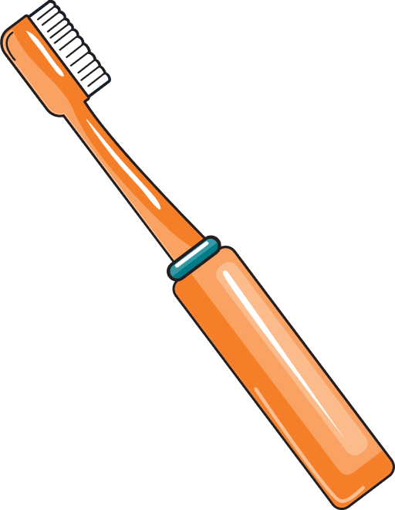
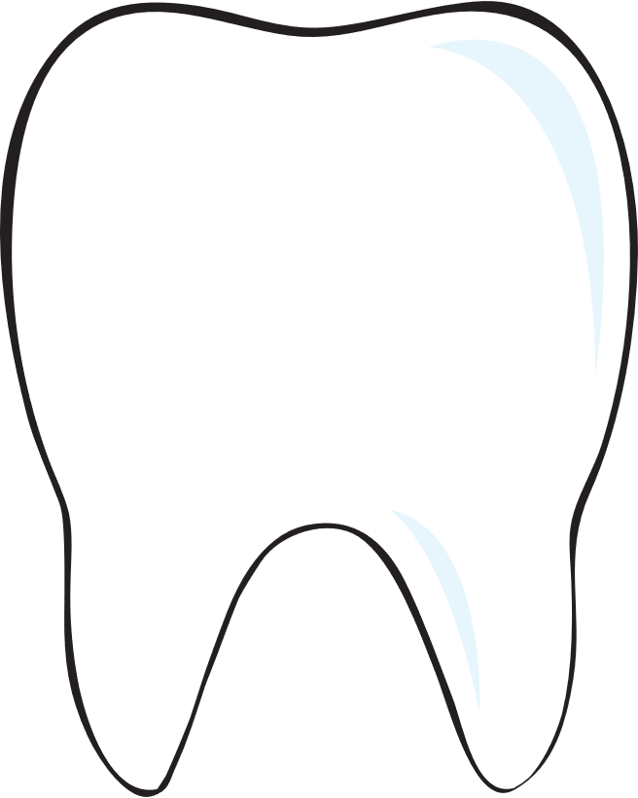

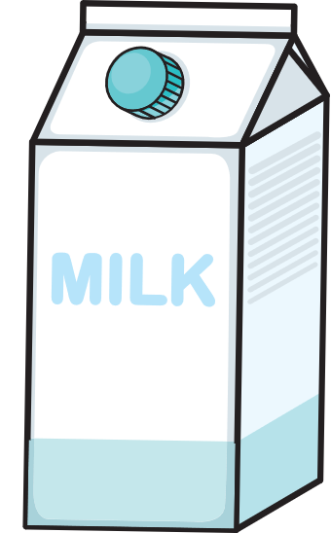
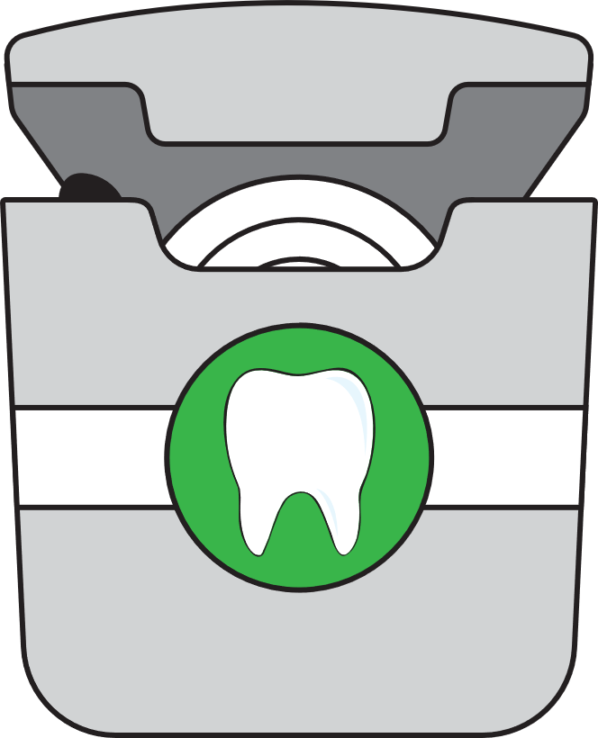
Mouth Wise Curriculum
Healthy teeth and gums impact overall health
Good nutrition contributes to healthy teeth
Brushing and flossing are important steps to good oral and overall health
Notes:
The Mouth Wise curricula all focus on a few main themes. First, healthy teeth and gums impact overall health. As we have talked about, poor oral health can have negative consequences on physical, social, and mental health as well as school success.
Brushing and flossing are important daily steps to good oral health. Even primary teeth need to be taken care of because they can have a lifelong impact on health.
Next, good nutrition contributes to healthy teeth. Healthy teeth are necessary for eating foods that will help our body stay healthy. Choosing nutrient-dense foods and limiting sugary food help our teeth stay healthy.
The Mouth Wise curriculum also discusses how to avoid mouth injuries and what to do if a tooth emergency happens.
Finally, for grades 6-8, the Mouth Wise curriculum highlights the consequences of tobacco use on oral health and provides them with strategies to make healthier choices.

Slide 18
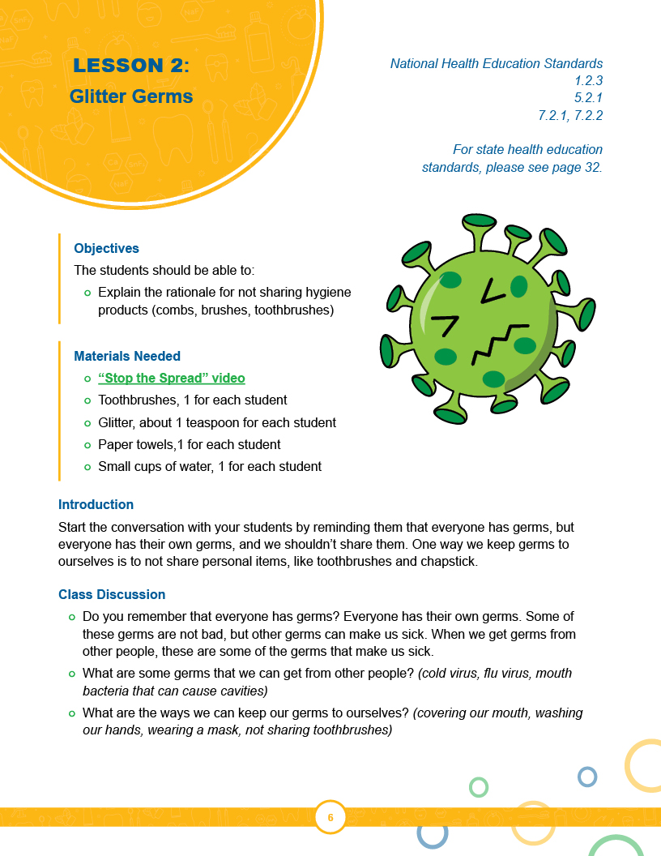
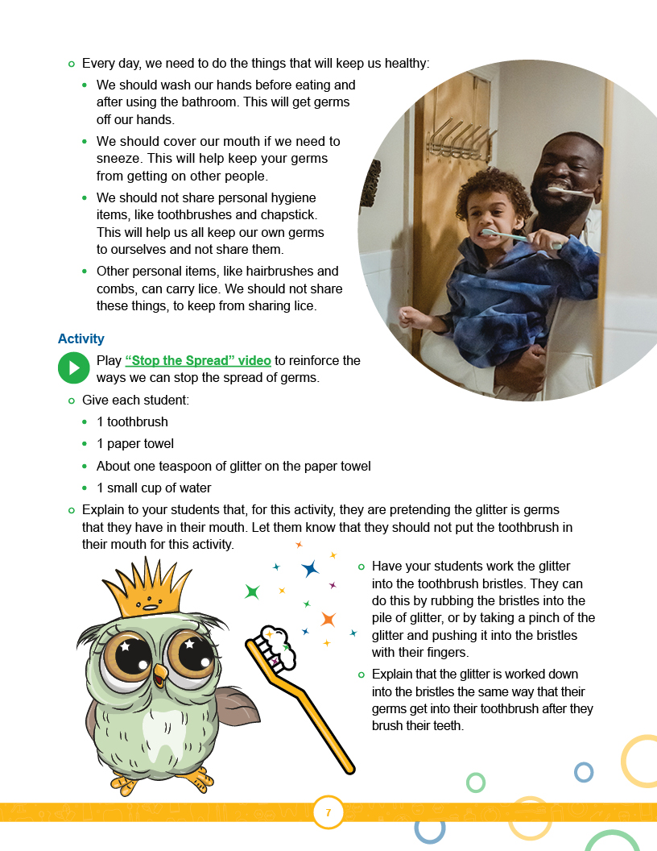
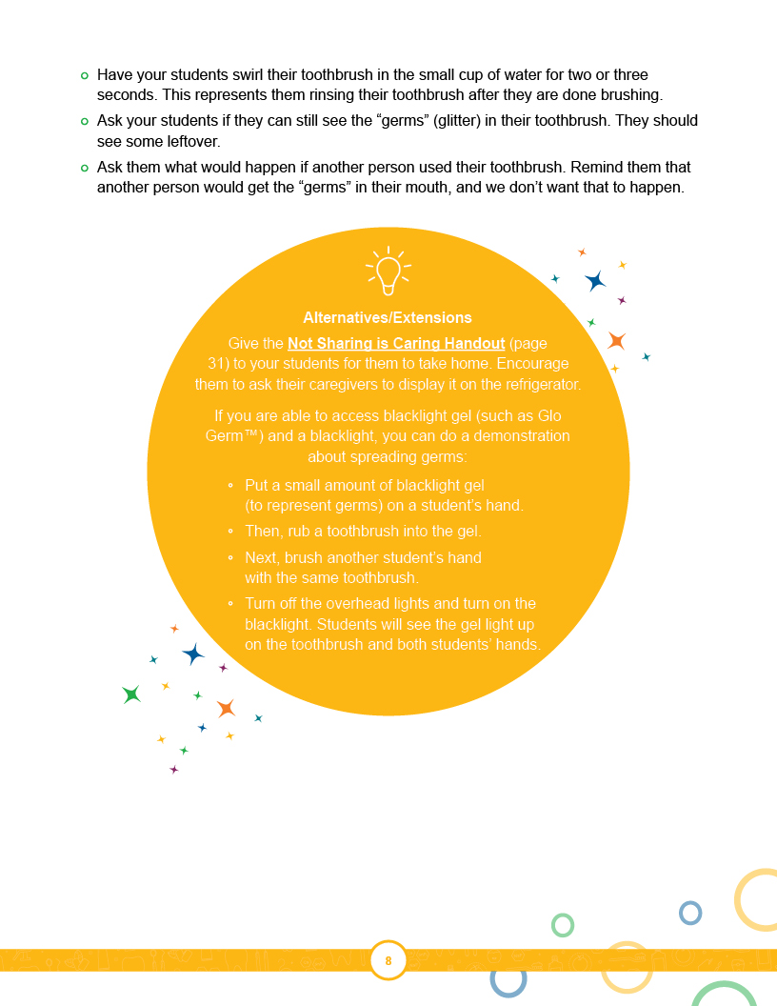
Mouth Wise Curriculum
Notes:
Each lesson in the Mouth Wise curriculum has the same layout, to make it easy to follow along every time.
At the top, you will find the National Health Education Standards that each lesson aligns with. You will also see the page number where you can find the state health education standards.
Next, each lesson has a list of objectives to let you know what your students will be learning about. Any materials you need to gather or print for the activity will be listed next. Some lessons will have optional materials. If that’s the case, you will see those listed just after the required materials.
The introduction is a paragraph that will get the conversation started about the topics covered in that lesson. Many of the lessons will ask you to play a video in the next step. Each video has educational material to teach your students what they need to know about the topic of that lesson.
After the videos, there is a guided class discussion. This is designed to expand on what your students learn in the videos. Last, each lesson has an activity. The activities are fun and engaging and were developed to help reinforce the oral health education your students receive.
There are alternative ideas and extensions you can use for every lesson. If your students are learning remotely, this section will have ideas you can use to conduct the lesson in a way that will still be fun and engaging for your students!

Slide 19
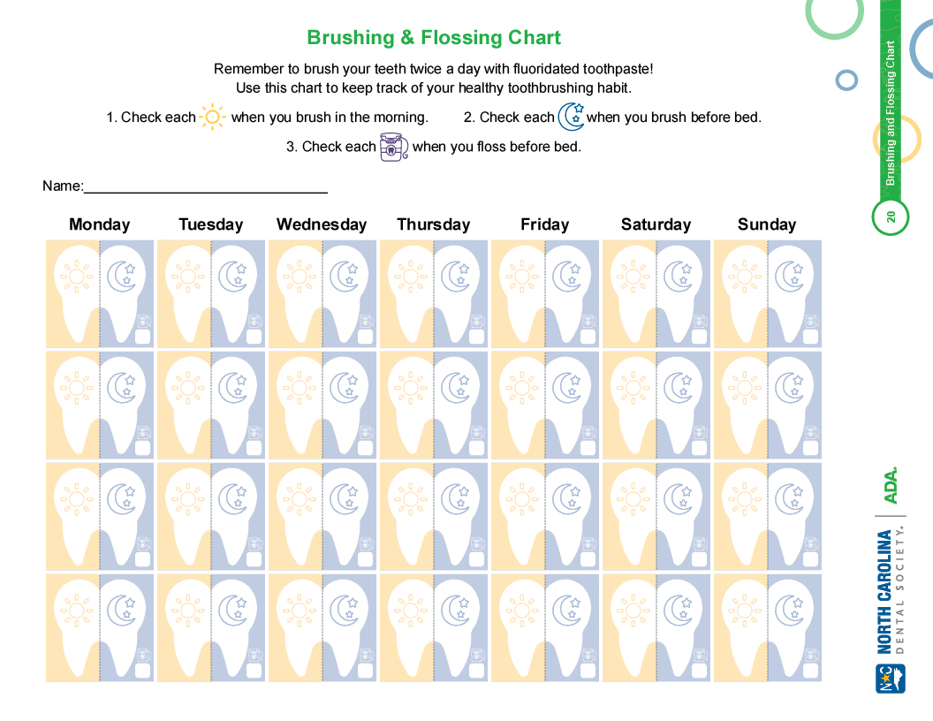
Next Steps
Notes:
The brushing and flossing chart is included in the curriculum for grades K-2 and 3-5. The chart is a way for you to encourage your students to take control of their own oral health care habits. Students can take these home and mark them every time they brush and floss. It’s up to you to decide how you encourage your students to complete this, but two suggestions are to make it a homework assignment or an extra credit opportunity.

Slide 20
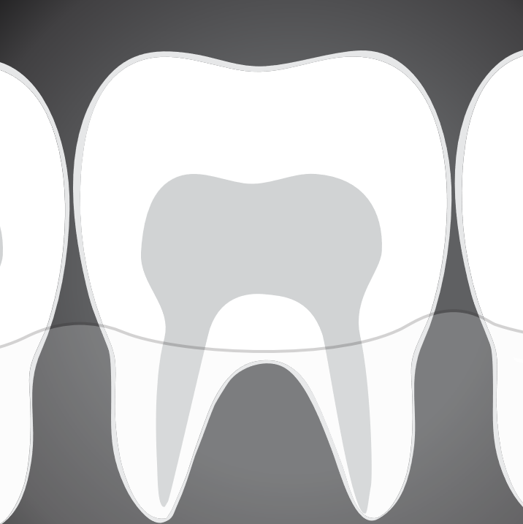
Next Steps
Keep the learning going!
  Include oral health tips in your class newsletter
  Remind students of the dangers of tobacco on oral health
  Talk about choosing nutrient-dense beverages over sugary ones
Notes:
After you finish the Mouth Wise lessons, the learning can keep going!
Teachers should keep talking about oral health in class and connecting to material from the Mouth Wise lessons.
For example, you can include oral health tips in your classroom newsletters. Or you can share about the oral health consequences of tobacco use. You can also talk about the benefits of drinking water instead of sugary beverages.

Slide 21
Development and Training by McMillen Health

Slide 22
References
U.S. Centers for Disease Control and Prevention. 2019. Oral Health. Accessed December 15, 2020. https://www.cdc.gov/healthyschools/npao/oralhealth.htm
Sheiham, Aubrey. 2005. Oral health, general health and quality of life. Bulleting of the World Health Organization. 83(9): September 2005, 641-720.
Seirawan, Hazem, Sharon Faust, and Roseann Mulligan. 2012. The Impact of Oral Health on the Academic Performance of Disadvantaged Children. Am J Public Health. 102(9): 1729-1734.

Slide 23
You are now ready to use the Mouth Wise curriculum!

Slide 24
Thank You for your participation!

